Slide 1








GROUP 5
Campus bus
tracking system
Secp1513-07
START

Slide 2

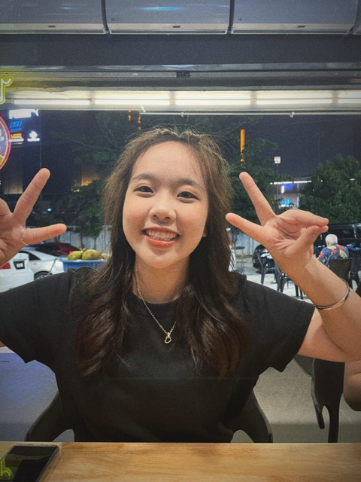
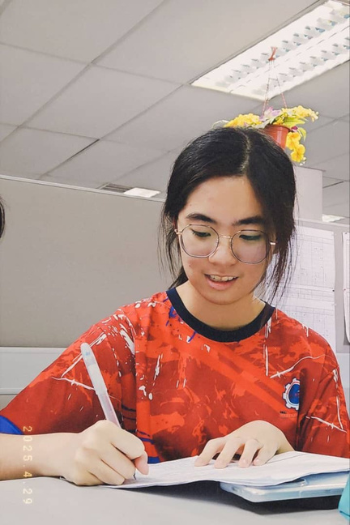
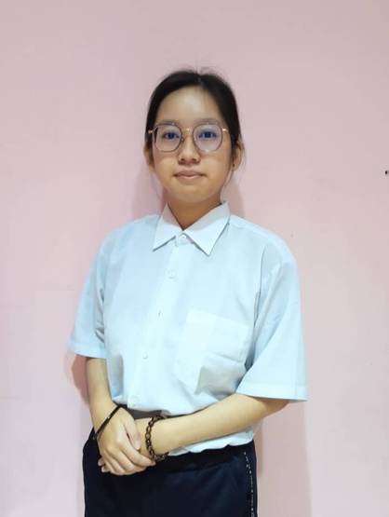
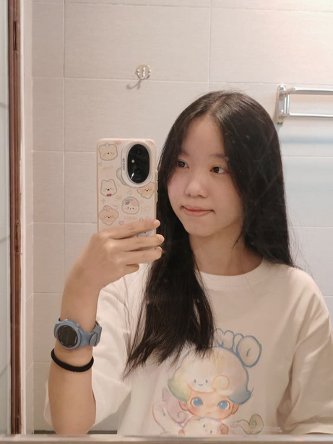
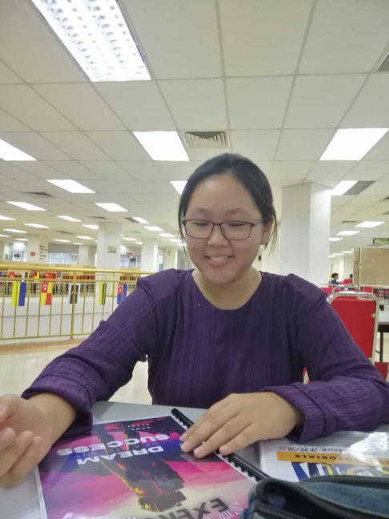
Group member
1
GROUP 5
TEO YING LING
A25CS0149
GAN LUO XI
A25CS0224
TAN JIA QI
A25CS0358
TOR SI JIE
A25CS0369
ANG HUI SHAN
A25CS0192

Slide 3








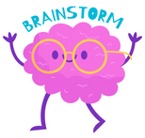

2
1 Introduction
2 Vision & Mission
CONTENTS:
3 Problem Statement
4 Solution
5 Teamwork
6 Prototype
7 Conclusion

Slide 4



3
INTRODUCTION
Developed to improve efficiency, reliability, and inclusiveness of campus transportation
Provides real-time bus location and arrival information
Helps students reduce waiting time and manage schedules better
Allows drivers to send delay notifications to users
Integrates AI system to improve accuracy of bus arrival predictions
Includes accessibility features for visually impaired and physically challenged users

Slide 5





4
VISION & MISSION
Vision:
To create a smart, reliable, and inclusive campus transportation system.
Mission:
Provide accurate real-time information
Improve communication between drivers and users
Support all students through accessible and innovative technology

Slide 6

5
PROBLEM STATEMENT
Absence of a tracking system that provides real-time bus location and estimated time of arrival (ETA)
students must estimate the bus arrival time by themselves
students waste their time waiting at bus stops
2. Unfamiliar with campus bus routes and schedules
students do not know which bus to take or which bus stop they should wait at
lack of a proper guidance system
3. Buses are not on time
bad weather, accident or breakdown
buses may also arrive earlier than scheduled

Slide 7

6
SOLUTION
Our Campus Bus Tracking Application enhanced with Big DATA and AI-powered features, aims to provide accurate, real-time and personalized information.

Slide 8

7
SOLUTION
plan the trip
real-time information
personalized notifications
AI chatbot assistant
bus drivers to update bus status
searching for bus stops
viewing available routes and schedule
tracking-distance
arrive time
crowded level of each bus
adjust their travel plans
simplifies access to information
usable for visually impaired users
reflected in the system and shared with students
This helps us provide more efficient services every day.

Slide 9


8
TEAMWORK
Task Assignment | Task Assignment | Task Assignment | Task Assignment | Task Assignment | Task Assignment
 | ANG HUI SHAN | GAN LUO XI | TAN JIA QI | TEO YING LING | TOR SI JIE
Report | Detail Description | Introduction, Front Page, Editing Report | Assign Task for Each Member, Produce and Testing Phototype | Detail Step and Descriptions,Design Thinking Assessment | Design Thinking Evidence, Make and conclude the result form Google Form
Video | Provide ideas for the Video (Problem Statement and Team-Working) | Provide ideas for the Video Introduction | Editing Video | Provide ideas for the (Video Detail Steps, Design Thinking Assessment Points) | Provide ideas for the Video (Result from Google Form)
Slide | Prototype | Teamwork | Solution | Introduction, Conclusion | Problem Statement

Slide 10

prototype
9
GROUP 5
Campus bus tracking system

Slide 11



10
CONCLUSION:
The Campus Bus Tracking App significantly improves campus transportation by making it faster, more reliable, and inclusive. Students benefit from real-time bus tracking, driver delay notifications, and AI-assisted predictions, which help them plan their schedules efficiently and reduce uncertainty. The app also prioritizes accessibility, ensuring that visually impaired and physically challenged students can travel independently and safely. By integrating technology with user-centered design, this app not only enhances daily commuting but also promotes a smarter, more organized, and student-friendly campus environment. Its impact goes beyond convenience, fostering a more inclusive and connected campus community.

Slide 12


GROUP 5
thank you!
END

